Slide 1
Introduction to the immune system
Vivekanandan Perumal
vperumal@bioschool.iitd.ac.in
011-26597532
Office hours Wednesday and Friday 5-6pm

Slide 2
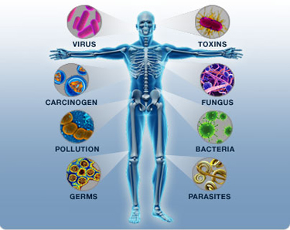
Immunity
Immunity is body's ability to resist or eliminate potentially harmful foreign materials or abnormal cells

Slide 3
History: what imparts Immunity?
Emil von Behring and Kitasato (1890)
  Serum from vaccinated animals was protective (diptheria)
Metchinkoff (1880)
  Cell based Immunity
Merrill Chase (1940)- Transfer of WBC (immunity to tuberculosis)
Both serum and cells contribute to immunity
Notes:
Emil von Behring -German
Kitasato –Japanese
Metchinkoff –Russian
Merrill Chase - American

Slide 4
Immunology- nobel prizes
Since 1901 there have been 19 Nobel Prizes for immunology-related research.
Notes:
Examples: Discovery of human blood groups (1930) and Transplantation immunology(1991),
Emil von Behring – nobel
Metchinkoff - nobel

Slide 5
The immune system
A functional system – NOT an organ system:
Complex system – includes
Skin – physical barrier
Lining of mucus membranes – physical barrier
Secretions – tears, mucus etc - antimicrobial
Blood cells and vasculature – WBCs
Bone marrow
Liver – makes complement proteins
Lymphatic system and lymphoid organs
Most tissues – have resident immune cells
Notes:
The lymphatic system is part of the circulatory system and a vital part of the immune system, comprising a network of lymphatic vessels that carry a clear fluid called lymph (from Latin lympha meaning water^{[1]}) directionally towards the heart. The lymphatic system was first described in the seventeenth century independently by Olaus Rudbeck and Thomas Bartholin. Unlike the cardiovascular system, the lymphatic system is not a closed system. The human circulatory system processes an average of 20 litres of blood per day through capillary filtration, which removes plasma while leaving the blood cells. Roughly 17 litres of the filtered plasma are reabsorbed directly into the blood vessels, while the remaining three litres remain in the interstitial fluid. One of the main functions of the lymph system is to provide an accessory return route to the blood for the surplus three litres.^{[2]}
The other main function is that of defense in the immune system. Lymph is very similar to blood plasma: it contains lymphocytes and other white blood cells. It also contains waste products and debris of cells together with bacteria and protein. Associated organs composed of lymphoid tissue are the sites of lymphocyte production. Lymphocytes are concentrated in the lymph nodes. The spleen and the thymus are also lymphoid organs of the immune system. The tonsils are lymphoid organs that are also associated with the digestive system. Lymphoid tissues contain lymphocytes, and also contain other types of cells for support.^{[3]} The system also includes all the structures dedicated to the circulation and production of lymphocytes (the primary cellular component of lymph), which also includes the bone marrow, and the lymphoid tissue associated with the digestive system.^{[4]}

Slide 6
Immunity
Immunity (immunis- Latin-exempt, state of protection from infectious diseases)
Immunity is body's ability to resist or eliminate potentially harmful foreign materials or abnormal cells
consists of following activities:
  Defense against invading pathogens (viruses & bacteria)
  Removal of 'worn-out' cells (e.g., old RBCs) & tissue debris (e.g., from injury or disease)
  Identification & destruction of abnormal or mutant cells (primary defense against cancer)
  Rejection of 'foreign' cells (e.g., organ transplant)
  Inappropriate responses:
    Allergies - response to normally harmless substances
    Autoimmune diseases

Slide 7
The Immune System

Slide 8
Overview of the Immune System
Immune System
Innate
(Nonspecific)
1º line of defense
Adaptive
(Specific)
2º line of defense
Interactions between the two systems
Notes:
Two arms of the immune system

Slide 9
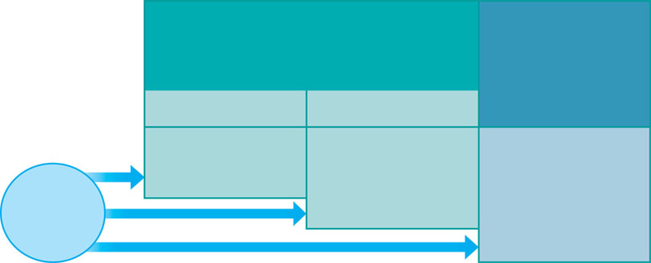
A typical immune response
INNATE IMMUNITY
Rapid responses to a
broad range of microbes
ACQUIRED IMMUNITY
Slower responses to
specific microbes
External defenses
Internal defenses
Skin
Phagocytic cells
Humoral response
(antibodies)
Mucous membranes
Antimicrobial proteins
Secretions
Inflammatory response
Invading
microbes
(pathogens)
Natural killer cells
Cell-mediated response
(cytotoxic
lymphocytes)
Complement

Slide 10
Innate immunity vs Adaptive Immunity
Innate Immunity
(first line of defense)
Adaptive Immunity
(second line of defense)
No time lag
A lag period
Not antigen specific
Antigen specific
No memory
Development
  of memory
Notes:
Analogy – IIT campus is the human body. The compound wall is the first line of defense or equivalent of innate immunity. It does not allow entry into the campus. Barbed wire fence may hurt intruders, if any. NO LAG, Not speific for any intruder (pathogen). It has no memory (It does not remember the intruder).
Let’s say an intruder manages to get into the campus. Then the second line of defense (let’s say security personnel) - get into action. They identify the intruder and pin him down and get him out. (Lag to mobilize resources, they just target a specific intruder (pathogen) and they remember the intruder and become better equipped if they encounter the same intruder again (Memory).

Slide 11
The innate immune System
Innate Immune System
External defenses
Internal
defenses
Interactions between the two systems
Notes:
Two arms of the immune system

Slide 12
Innate immune system
External defenses

Slide 13
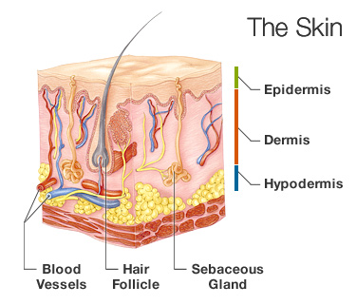
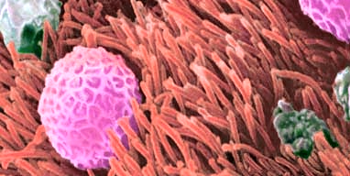
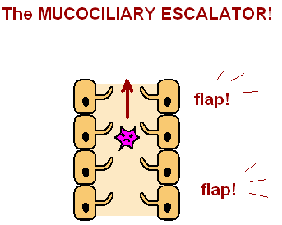
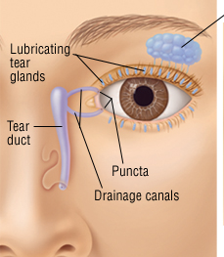
Anatomical Barriers - Mechanical Factors
Skin
Mucociliary escalator
Flushing action of
saliva, tears, urine

Slide 14
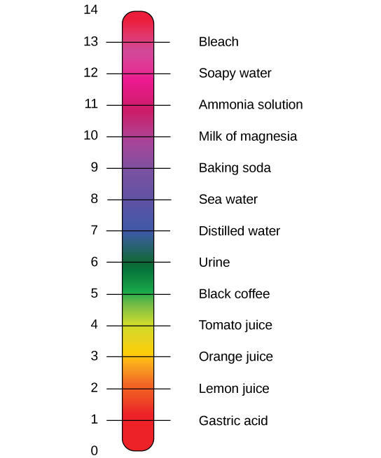
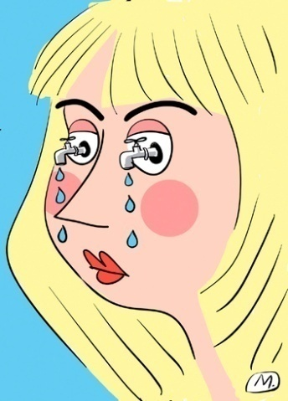
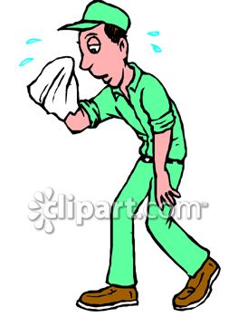
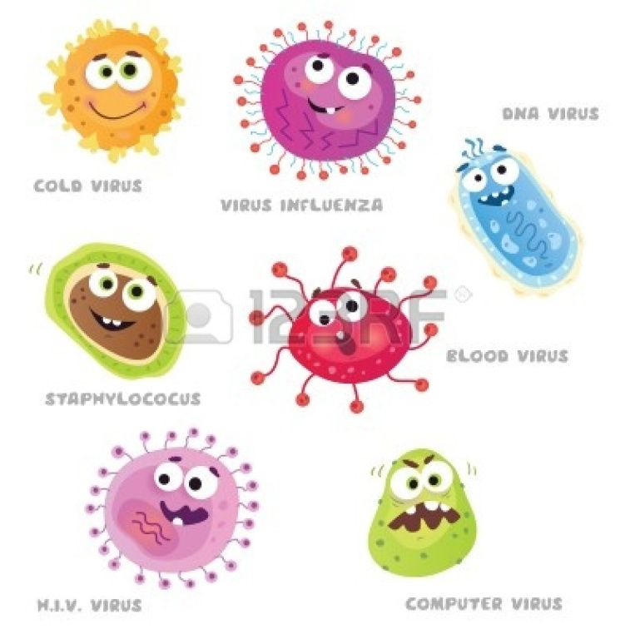
Anatomical Barriers – Chemical factors
Lysozyme in tears /saliva
Antimicrobial
Peptides in sweat
HCl in stomach
Notes:
Sweat – AMP – dermcidin

Slide 15
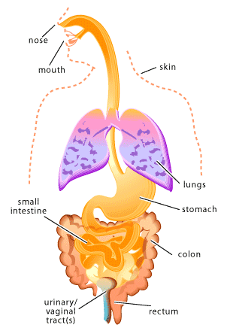
Anatomical Barriers – Biological factors
Normal flora – microbes in many parts of the body
Normal flora – > 1000 species of bacteria
Normal flora – competes with pathogens
for nutrients and space

Slide 16
Innate immune system internal defenses

Slide 17
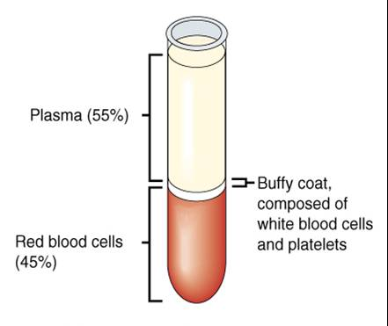
Innate immune system: components of Blood
Complement proteins
Coagulation proteins
Extracellular
Cytokines
WBCs

Slide 18
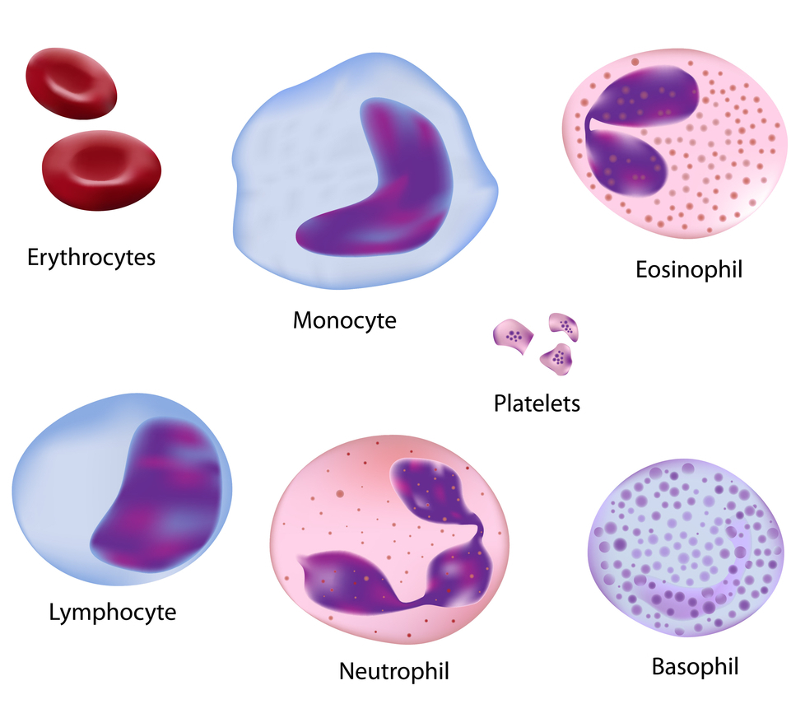
White blood cells (WBCs)
Macrophages
B-lymphocytes
T-lymphocytes
Natural killer(NK) cells
Mast cells

Slide 19
Neutrophils in innate immune response
Most abundant WBCs (~50-60%)
Efficient phagocytes
Most important cells of the innate immune system

Slide 20
Phagocytosis
Phago = to eat
Cyte = cell
WBCs (eg. Neutrophils) – find, eat and digest microbes !

Slide 21
How do neutrophils find microbes ?
https://youtu.be/I_xh-bkiv_c
https://www.youtube.com/watch?v=ZUUfdP87Ssg

Slide 22
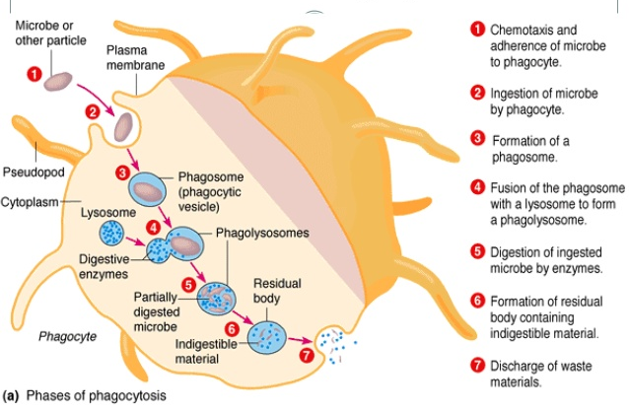
How do neutrophils eat and digest microbes ?
Granules
Notes:
Two additional roles: Antigen presentation – (role in adaptive immunity)
Triggers an inflammatory repsonse

Slide 23
What’s in the granules ?
Lysozyme – digests bacterial cell wall; other antimicrobial proteins
Notes:
Two additional roles: Antigen presentation – (role in adaptive immunity)
Triggers an inflammatory repsonse

Slide 24
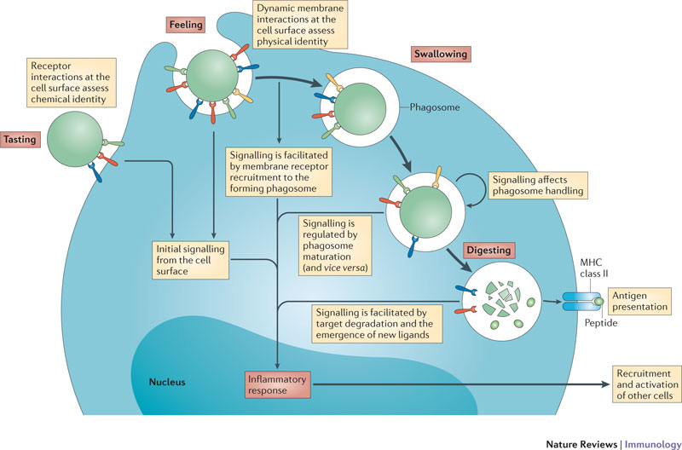
Additional role of neutrophils
Triggers inflammatory response
Notes:
Two additional roles: Antigen presentation – (role in adaptive immunity)
Triggers an inflammatory repsonse

Slide 25

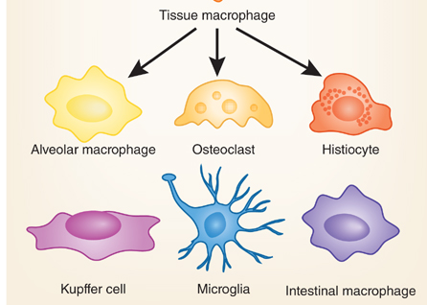
Monocytes
Monocytes (~5% of WBCs)
Migrate into the tissues and become Macrophages
Lung Bone
Liver Brain intestine

Slide 26
Macrophages
“Big eaters”
Phagocytosis of microbes in tissue
(neutrophils are present only in blood)
Antigen presentation
Notes:
Increased number of adipose tissue macrophages correlates with increased adipose tissue production of proinflammatory molecules.

Slide 27
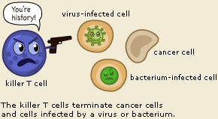
Natural killer cells
Not B-lymphocytes / T-lymphocytes
Important part of the innate immune system
Kill virus /bacteria infected cells (Intracellular pathogens)
Kills cancer cells
Notes:
are defined as large granular lymphocytes (LGL)

Slide 28
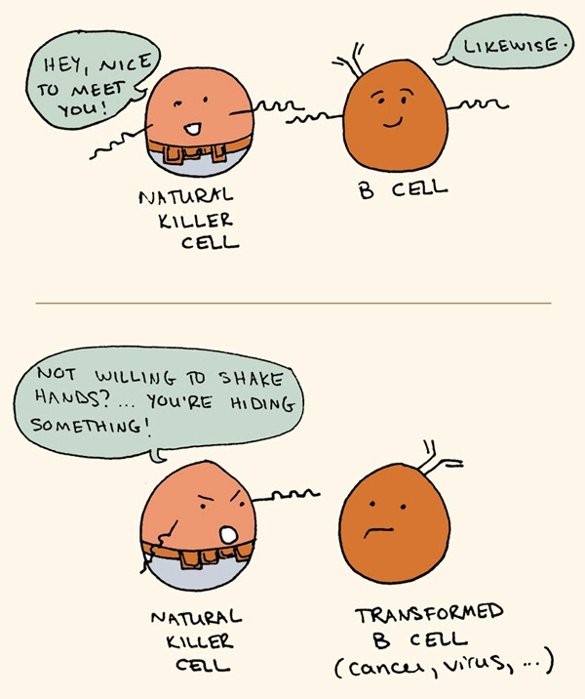
NK cells differentiate choose cells to kill ?
Uninfected cell / Normal cell
Microbe infected cell / cancer cell
Some cell surface proteins are missing

Slide 29
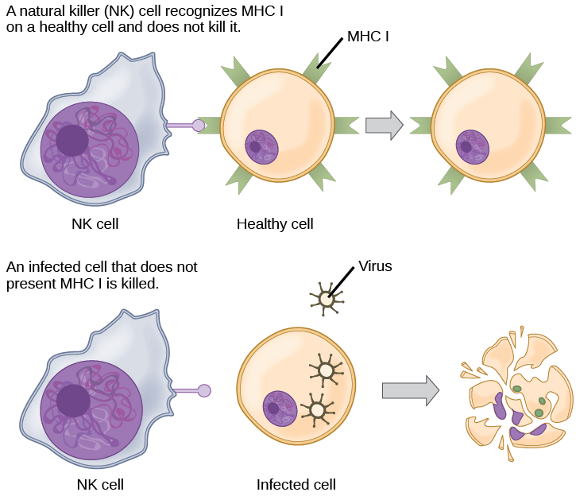
How does the killer kill ?
Kills both host cells and microbes
Release of granules with perforins and proteases

Slide 30
Toll-like receptors (TLRs)
Transmembrane proteins
Present on macrophages / few other cells
Conserved across vertebrates
Important part of innate immune system

Slide 31
TLRs – What do they do ?
They look out for microbes (or their components)
They bind to the microbes (or their components)
They trigger a cascade of events to kill or protect against pathogens
THEY ARE INNATE IMMUNE SENSORS

Slide 32
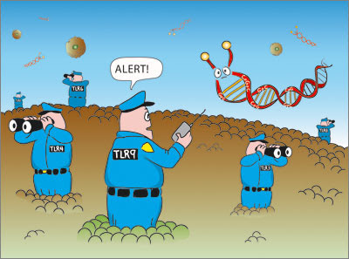
TLRs – look out for microbes

Slide 33
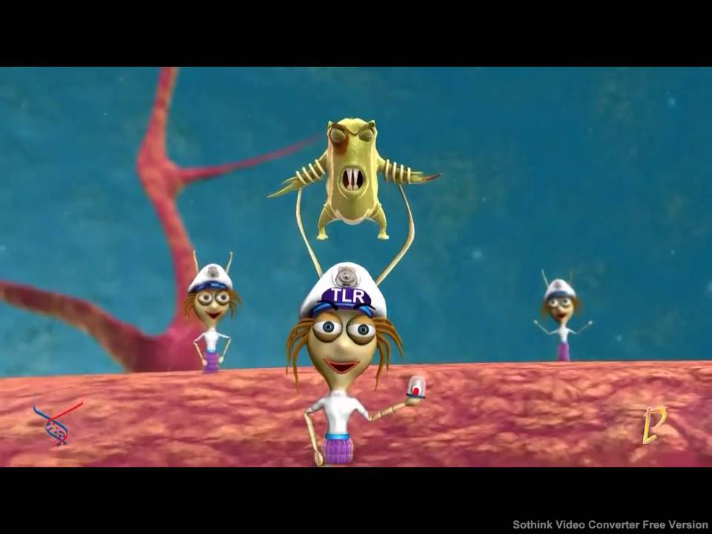
TLRs – bind to microbes / components of microbes

Slide 34
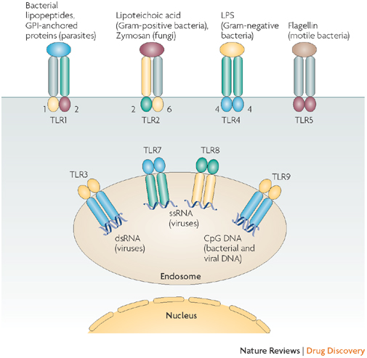
Which microbial components are recognized by TLRs ?

Slide 35
What happens when a TLR bind to a microbe ?
Secretion of Cytokines / Interferon
Enhanced immune response
Inflammation
Phagocytosis of infected cell
TLR binding to microbe
Apoptosis of infected cell
Killing of infected cell

Slide 36
Summary: innate response – internal defenses – Cellular (WBCs)
Come into play when the external defenses are breached
Neutrophils
Monocytes /macrophages
NK cells
TLRs

Slide 37


Innate immune system: components of Blood
Complement proteins
Coagulation proteins
Cytokines
WBCs

Slide 38
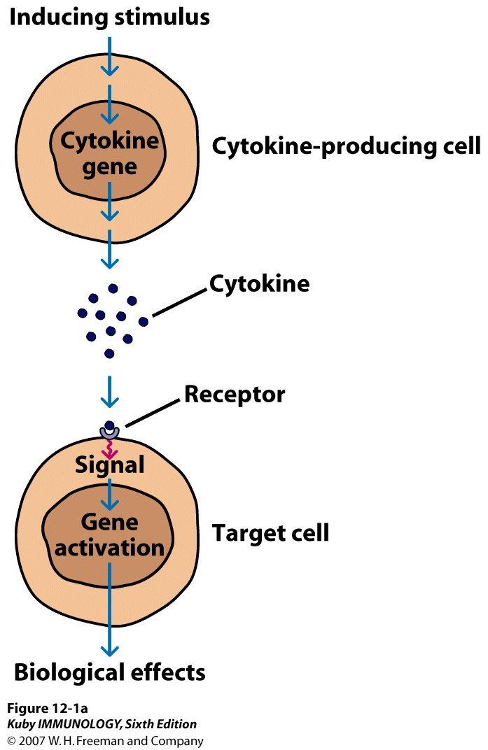
Cytokines
Small proteins – secreted by cells of the immune system
Affect the behaviour of other cells
signalling molecules
Key players in innate and acquired immunity

Slide 39
Which cells release cytokines ?
Cells of the immune system:
Neutrophils – when they encounter a pathogen
Macrophages – when they encounter a pathogen
TLRs – bind to microbe / components of a microbe
NK cells – on encountering a microbe infected cell /tumour cell
Lymphocytes – when they are activated

Slide 40
Examples of cytokines
Interferons
Interleukins
Tumour necrosis factor (TNF)

Slide 41
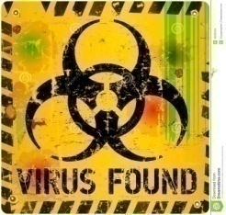
Interferons (IFN)
Signalling proteins produced by by virus infected monocytes and lymphocytes
Secreted proteins – Key anti-viral proteins
“Interfere” with virus replication
Warn the neighbouring cells that a virus is around...
If we did not have IFNs – most of us may die of influenza virus infection

Slide 42
How does IFN warn the neighbouring cells ?

Slide 43
The infected cells release IFN
antiviral state
antiviral state
antiviral state
antiviral state

Slide 44
Virus infects the neighbouring cells
antiviral state
antiviral state
antiviral state
antiviral state

Slide 45
Prewarned cells are able to quickly inhibit the virus
antiviral state
antiviral state
antiviral state
antiviral state

Slide 46
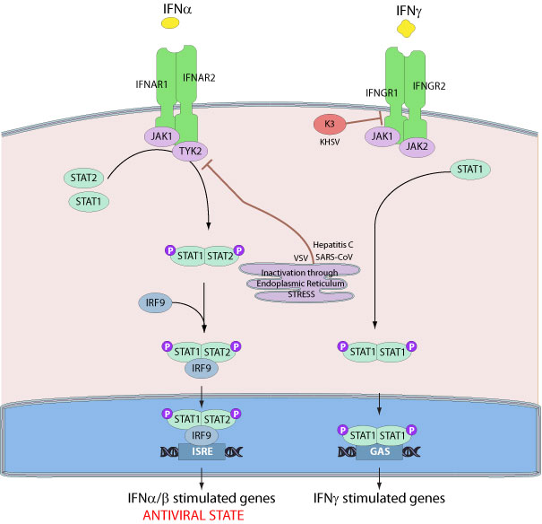
How do interferons inhibit viruses ?
Inactive host protein
Induction
Virus ds-RNA
Activation
Host protein
Active host protein
Cascade of events
Inhibition of host protein synthesis
Virus cannot replicate

Slide 47
Interleukins
Interleukins – 1-37
Not stored inside cells
Quickly synthesized and secreted in response to infection
Key modulators of behaviour of immune cells
Mostly secreted by T-lymphocytes & macrophages

Slide 48
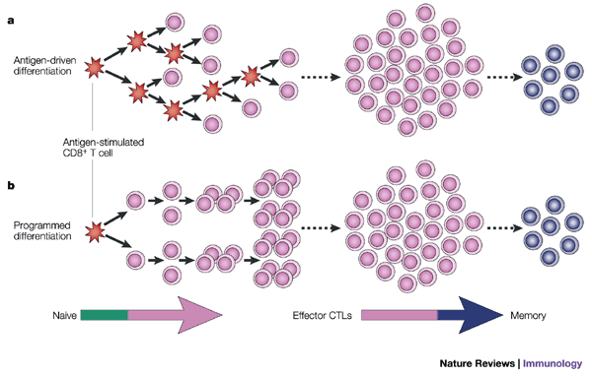
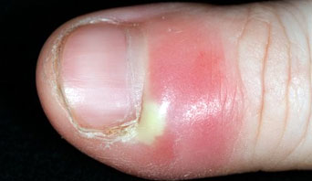

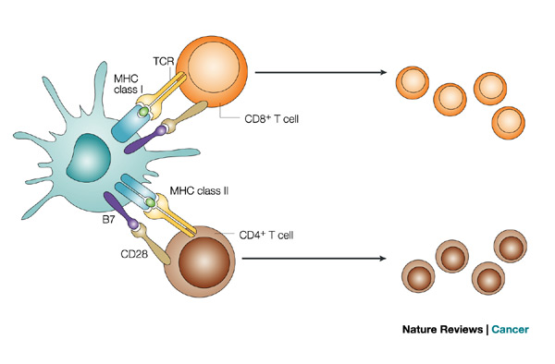
What to interleukins do ?
Proliferation of immune cells
Interleukins
Increase antibody production
Inflammation
Activation of immune cells

Slide 49
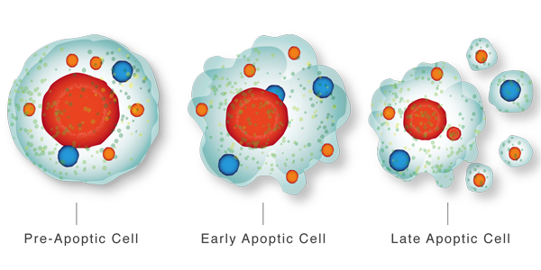
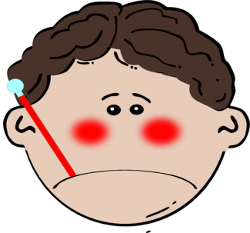

Tumour necrosis factor (TNF)
TNF
Killing of cancer
Fever
Inflammation

Slide 50
Complement (C`)
a large number of distinct plasma proteins that react with one another (C1 thro’ C9)
Complement can bind to microbes and coat the microbes
Essential part of innate immune response
Enhances adaptive immune resposne (taught later)
Notes:
C` recognizes PAMPs on microbes and binds to them......

Slide 51
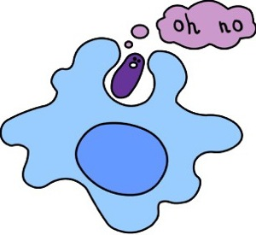
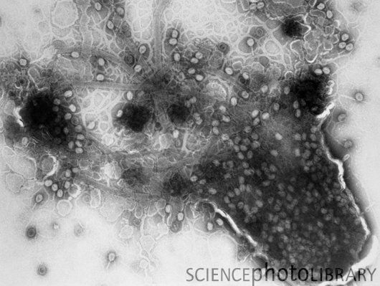
Complement proteins: role in innate immune system
C`proteins
Inflammation
Facilitates phagocytosis
Direct lysis of pathogens

Slide 52
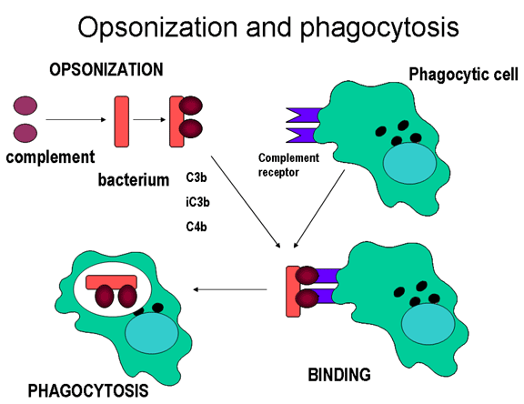
How do C` proteins facilitate phagocystosis ?
Bacteria coated with C`
Neutrophils have C` receptors
Initiation of phagocytosis

Slide 53
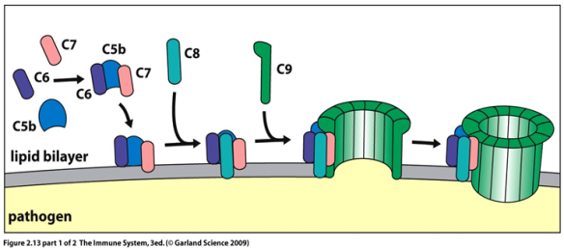
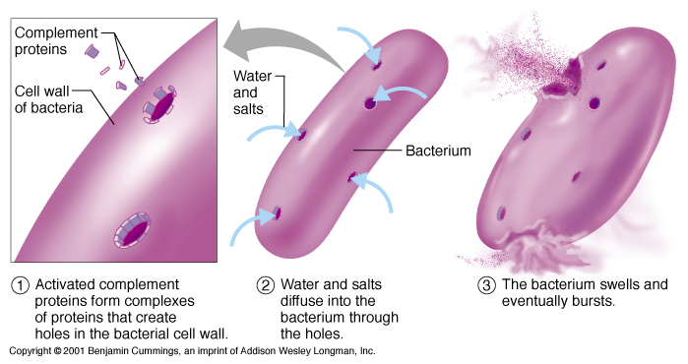
How do C` proteins lyse pathogens?
Membrane attack complex formed by c` proteins

Slide 54
Coagulation proteins
Coagulation: mechanism to stop bleeding after injury to blood vessels
Complex pathway involves
Platelets
Coagulation factors
Vitamin K
Notes:
Terminology: Blood clotting is also called coagulation. Hemostasis is a word for the process where a blood clot forms.
Blood clots form to stop excess blood leaking from your body after you break or cut the surface of your skin. If a blood vessel (a capillary, vein or artery) is damaged (internally or by external injury like a cut) bleeding occurs until a clot forms. Once the site of injury has healed, the blood clot will naturally dissolve. If no blood clot forms it is called a hemorrhage. A hemorrhage is uncontrolled bleeding and can be highly dangerous. Hemophiliacs are people with a blood disorder where there blood does not clot. A small injury can lead to uncontrolled bleeding. In the 1960s, before treatment became available, the life expectancy of someone with hemophilia was just 11 years. Today fortunately, with regular infusions of clotting medications, most can expect to live a relatively normal life expectancy.

Slide 55
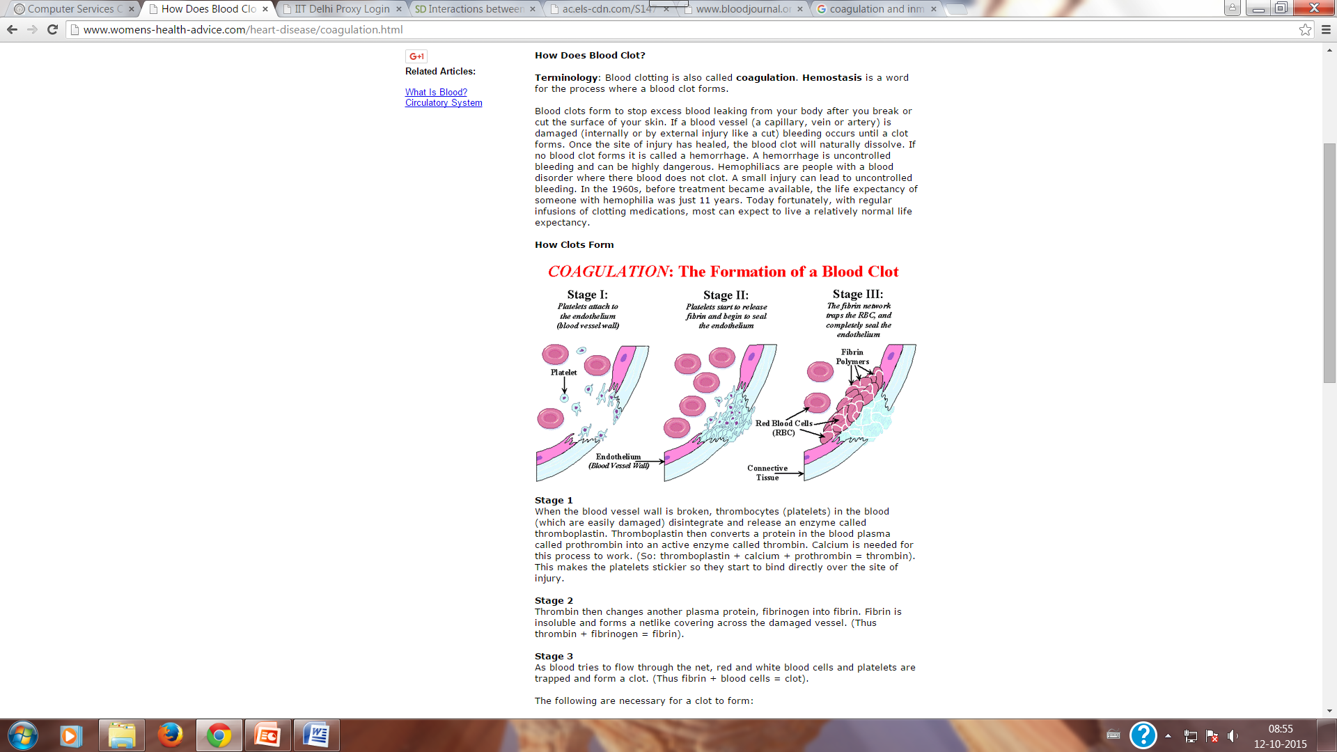
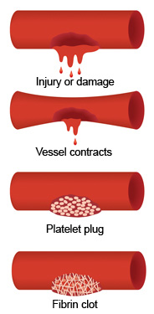
How does blood clot ?

Slide 56

Coagulation: Delicate balance
Coagulation proteins
Anticoagulants
Blood clotting
Inflammation
Apoptosis (prog. Cell death)
Prevent blood clotting
Inhibit inflammation
Inhibit apoptosis
Too much of clotting – Problem
Too little clotting - Problem
Maintenance of a balance
Notes:
Antithrombin, protein C and protein S are anticoagulants.
Other functions of coagulation proteins – by cross-talk......

Slide 57

Coagulation and innate immunity
Pathogens and cytokines
Anticoagulants
Coagulation proteins
Increased inflammation and increased apoptosis of infected cells

Slide 58
Summary: what happens when external defenses fail ?
INNATE IMMUNITY
Rapid responses to a
broad range of microbes
ACQUIRED IMMUNITY
Slower responses to
specific microbes
External defenses
Internal defenses
Skin
Phagocytic cells
Humoral response
(antibodies)
Mucous membranes
Antimicrobial proteins
Secretions
Inflammatory response
Invading
microbes
(pathogens)
Natural killer cells
Cell-mediated response
(cytotoxic
lymphocytes)
Complement

Slide 59
Summary: innate response – internal defenses
Cellular
Neutrophils
Monocytes /macrophages
NK cells
TLRs
Extracellular
Cytokines
Complement
Coagulation

Slide 60
Introduction to the immune system
Vivekanandan Perumal
vperumal@bioschool.iitd.ac.in
011-26597532
Office hours Wednesday and Friday 5-6pm

Slide 61
Immunology: lecture 3
Inflammation
Antigens
Antibody

Slide 62
Inflammation
Complex biological process by which body responds to pathogens and irritants
Associated with swelling of tissue
Key player in innate immune repsone

Slide 63
All roads lead to inflammation
Neutrophils
Coagulation proteins
Inflammation
Monocytes /macrophages
C` proteins
NK cells
Cytokines /IFN
TLRs
Cellular
Extracellular

Slide 64
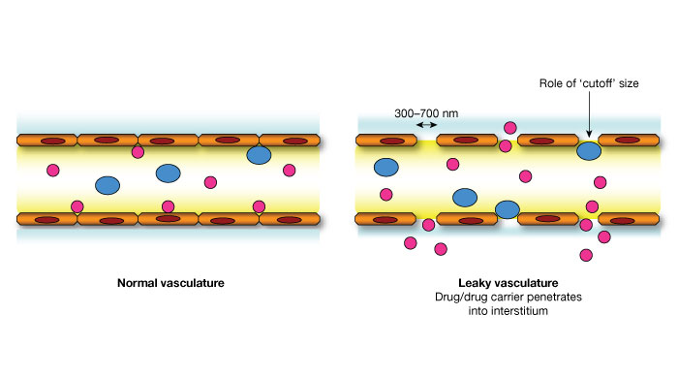
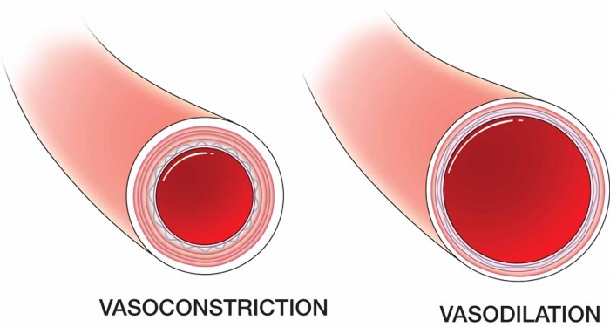
Inflammation and vascular changes
Vasodilatation
Increased capillary permeability
Normal blood vessel
Normal blood vessel
Dilated blood vessel
Leaky blood vessel

Slide 65
Signs of inflammation
Vascular changes
Vasodilatation
Capillary permeability
Heat / redness
Swelling
Pain
Fever
Temporary loss of function
Notes:
Heat – increases metabolic rate – leads to fever
Compression of nerve endings due to swelling leads to pain
Temp loss of function – eg. Joint not usable due to inflammation

Slide 66
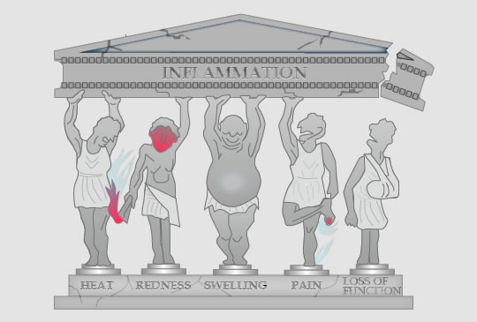
Signs of inflammation

Slide 67
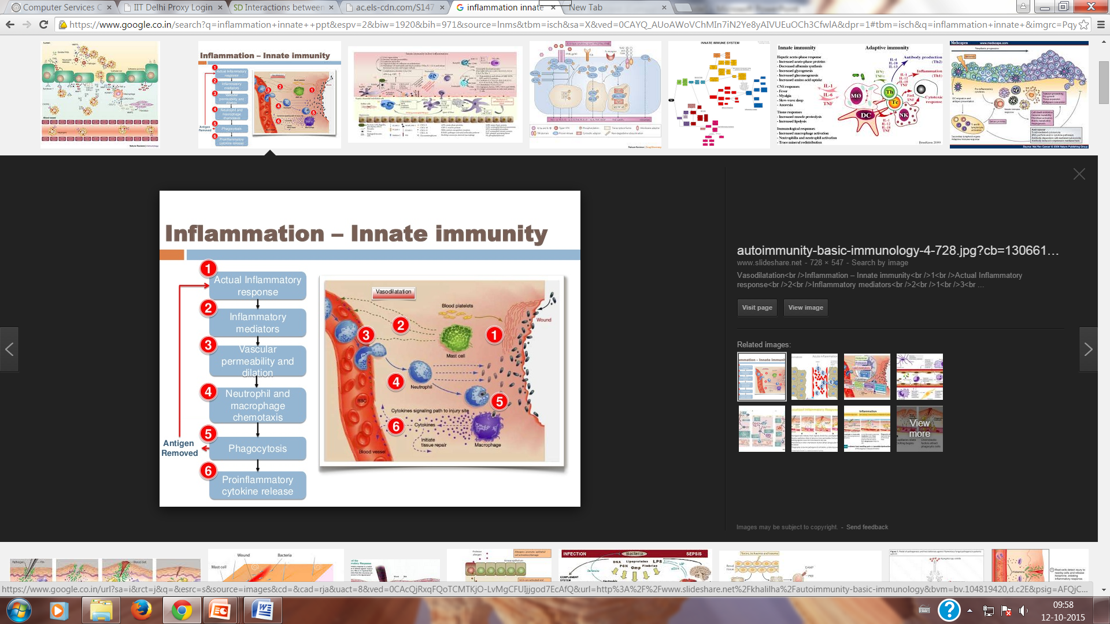
Inflammation and innate immunity
Histamine
Pathogen removal
+ + +
Adaptive immune response
Mast cells – similar to basophils in blood;
mast cells are present in tissues and release histamines in response to wound / infection /irritant

Slide 68
Summary: role of Inflammation in innate immunity
Initiation of phagocytosis – killing of pathogen
Limiting the spread of infection
Stimulate adaptive immune response
Initiate tissue repair

Slide 69
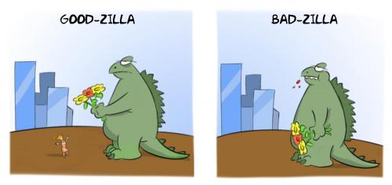
Not everything about Inflammation is good
Notes:
Same is true for many components of the immune system – several of them may have undersired effects.....

Slide 70
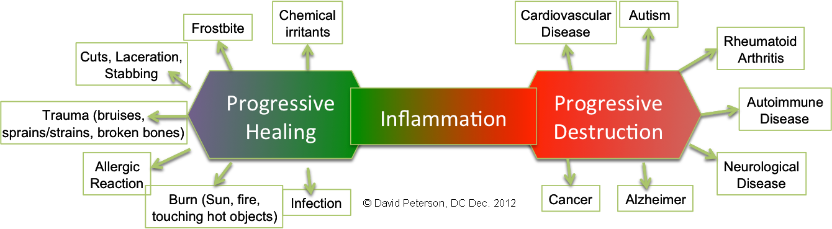
The good and bad about inflammation
Acute /short-term -Good
chronic /long-term - Bad

Slide 71
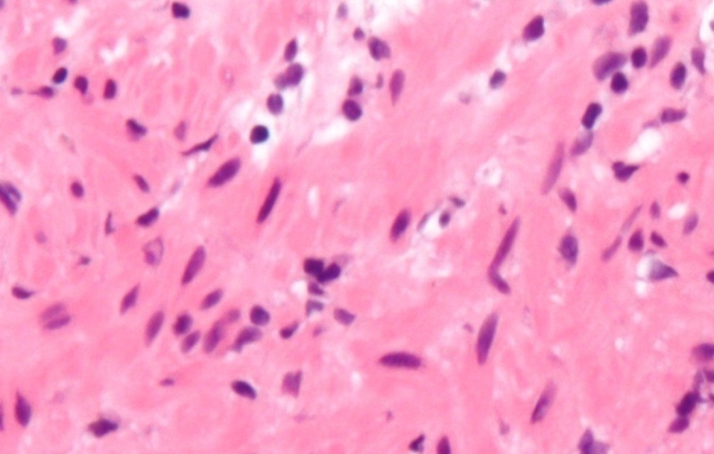

Chronic inflammation = tissue damage
Normal tissue
Chronic inflammation - macrophages in the injured tissue.
Macrophages release toxins (including reactive oxygen species or ROS) that injure tissues
chronic inflammation is almost always accompanied by tissue destruction.
Tissue : chronic inflammation

Slide 72
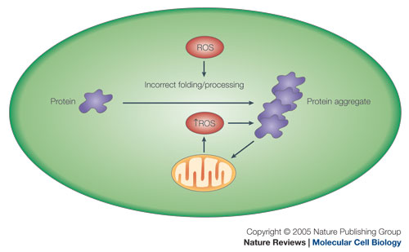
Chronic inflammation and tissue damage
Chronic inflammation
Reduced tissue function
Tissue damage
Activation of immune cells
Killing of host cells
Notes:
Reactive oxygen species (ROS) are chemicallyreactive molecules containing oxygen. Examples include peroxides. superoxide, hydroxyl radical,
Since these calcium regulatory proteins are also preferentially oxidized or nitrated under in vitro conditions, these results suggest an enhanced sensitivity of these critical calcium regulatory proteins, which modulate signal transduction processes and intracellular energy metabolism, to conditions of oxidative stress. Thus, the selective oxidation of critical signal transduction proteins probably represents a regulatory mechanism that functions to minimize the generation of ROS through respiratory control mechanisms. The reduction of the rate of ROS generation, in turn, will promote cellular survival under conditions of oxidative stress, when reactive oxygen and nitrogen species overwhelm cellular antioxidant defense systems, by minimizing the non-selective oxidation of a range of biomolecules. Since protein aggregation occurs if protein repair and degradative systems are unable to act upon oxidized proteins and restore cellular function, the reduction of the oxidative load on the cell by the down-regulation of the electron transport chain functions to minimize protein aggregation. OXIDATIVE damage to cellular proteins

Slide 73
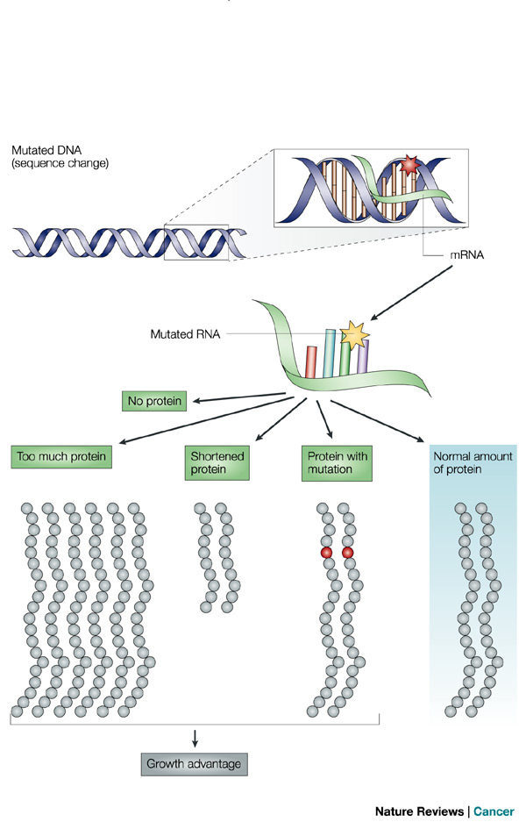
Chronic inflammation and Cancer
ROS
O₂⁻ OH⁻
DNA Mutation
Cancer
Notes:
8-hydroxyl guanine – oxidative DNA damage – more mutable

Slide 74
Immunogens / Antigens

Slide 75
Immunogens and antigens
Immunogen / antigen: a substance that elicits an immune response [i.e. a humoral (antibody response) or cell-mediated immune response]
Immune response generator
Though the two terms are used interchangeably – there are differences between the two
Notes:
Antigen: any substance that binds to an antibody (or a T-cell receptor) – But some antigens cannot elicit an immune response.
All immunogens are antigens but not all antigens are immunogens

Slide 76
Epitope
Epitope: the portion of an antigen that is recognized and bound by an antibody (Ab) or a T-cell receptor (TCR)
epitope = antigenic determinant

Slide 77
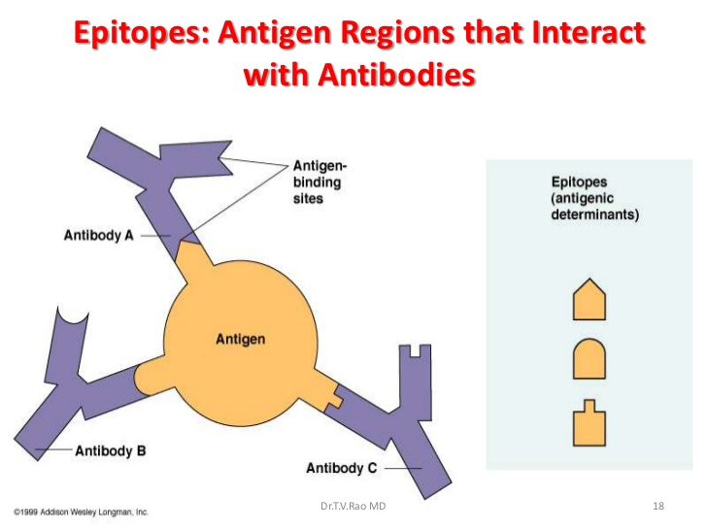
Epitopes
Epitope: the portion of an antigen that is recognized and bound by an Ab or a T Cell receptor
One protein may have multiple antigenic determinant

Slide 78
Epitopes
B-cell Epitopes – recognized by B-cells
T-cell Epitopes – recognized by T cells

Slide 79
Immunogenicity
Immunogencity: is the ability to induce a humoral (antibody) and/or cell-mediated immune response.
Weak immunogens
Strong immunogens

Slide 80
What determines immunogenicity ?
Foreignness: essential for immunogenicity (self-responsive immune cells are eliminated during lymphocyte development)
Size: Bigger>Smaller
Chemical composition: Proteins > nucleic acids / polysaccharides / lipids
Structure: Primary /secondary /tertiary structures play a role
Physical form: Particulate> Soluble
Notes:
Most immunogens are ≥ 100,000 daltons (Da)
Most molecules < 5-10,000 are poor ones

Slide 81
Host factors affecting immunogencity
Difference across species (interspecies)
Differences within a species (intraspecies)
- Responders / non-responders to vaccine
- differences in disease severity in epidemics
Genetics
Age
Notes:
Same virus – one dies other recovers in 2 days
Dengue virus –
Genetics ; MHC differences
Age – too young and too old are more susceptible

Slide 82
Isoantigens
Isoantigens: Antigens present in some but not all members of a species
Blood group antigens – basis of blood grouping
MHC (major histocompatibility complex)- cell surface glycoproteins
Notes:
Rhesus
Alloantigens are same as isoantigens

Slide 83
Autoantigens
Autoantigens are substances capable of immunizing the host from which they are obtained.
Self antigens are ordinarily non-antigenic
Modifications of self-antigens are capable of eliciting an immune response
Notes:
Under ordinary conditions they do not come in contact with the immunizing systems of the body, therefore antibodies are not produced against such cells and tissues. However, if these tissues are injured, then autoantigens may be absorbed, and may cause the production of antibodies which have a toxic effect on the corresponding cells.
Triggers of autoantibody production
cooling, radiation,
drugs (amidopyrine, sulphonamides, preparations of gold, etc.),
virus infections "(virus pneumonias and mononucleosis),
acterial proteins and toxins of streptococci, staphylococci, tubercle bacilli, paraproteins

Slide 84
Haptens
Haptens are small molecules which are non-immunogenic, thus could never induce an immune response by themselves.
Notes:
they may be able to bind to Ab’s or TCR’s

Slide 85
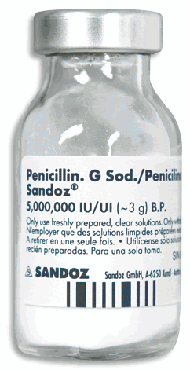
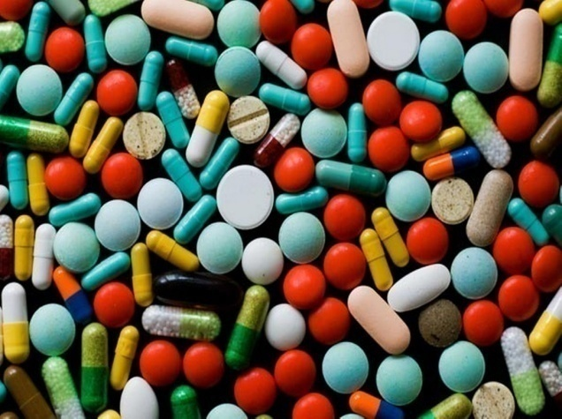
Examples of haptens
DO NOT ELICIT an immune response by themselves

Slide 86
Immunogens / Antigens

Slide 87
What is an antibody?
Produced by Plasma cell (B-lymphocytes producing Ab)
Essential part of adaptive immunity
Specifically bind a unique antigenic epitope (also called an antigenic determinant)
Possesses antigen binding sites
Members of the class of proteins called immunoglobulins

Slide 88
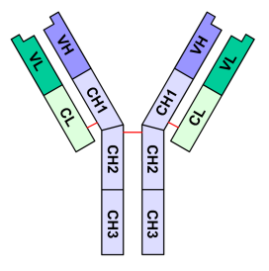
What does an antibody look like ?
2 identical heavy chains
2 identical light chains
Each heavy chain – has a constant and a variable region
Each light chain has a constant and a variable region
Variable region
L
L
Constant region
H
H

Slide 89

Antibody: structure and function
Fab – fragment antigen binding
Fc- Fragment constant
Notes:
Antibodies can also be divided into two regions based on their functions. The tip of the “Y”, consisting of one constant and one variable domain from each heavy and light chain of the antibody, contains the region that binds the antigen. It is for this reason that we call it the Fab (fragment, antigen binding) region. The base of the “Y”, composed of two heavy chains, plays a a role in modulating immune cell activity. This region is called the Fc (Fragment, crystallizable) region. The Fc region can bind to cell receptors, complement proteins, as well as to other immune molecules, thereby initiating different physiological effects including opsonization, cell lysis, and degranulation.

Slide 90
Antibody: Fab
Fab region
Variable region of the antibody
Tip of the antibody
Binds the antigen
Specificity of antigen binding determined by
V_{H} and V_{L}
Notes:
Antibodies can also be divided into two regions based on their functions. The tip of the “Y”, consisting of one constant and one variable domain from each heavy and light chain of the antibody, contains the region that binds the antigen. It is for this reason that we call it the Fab (fragment, antigen binding) region. The base of the “Y”, composed of two heavy chains, plays a a role in modulating immune cell activity. This region is called the Fc (Fragment, crystallizable) region. The Fc region can bind to cell receptors, complement proteins, as well as to other immune molecules, thereby initiating different physiological effects including opsonization, cell lysis, and degranulation.

Slide 91
Antibody: Fc
Fc region
Constant region
Base of the antibody
Can bind cell receptors and complement proteins

Slide 92
Antibodies exist in two forms
Antibodies occur in 2 forms
  Soluble Ag: secreted in blood and tissue
  Membrane-bound Ag: found on surface of B-cell, also known as a B-cell receptor (BCR)
Notes:
Making of an Agent: How they are generated
Antibodies can occur in two forms – a soluble form secreted into the blood and tissue, and a membrane-bound form attached to the surface of a B-cell. If the antibody is membrane-bound, it is called a B-cell Receptor (BCR). B-cell receptors detect circulating antigens present in the body, and triggers the activation of the B-cell. Activated B-cells either become antibody factories, called Plasma cells, or they differentiate into memory B-cells. Memory B-cells survive for years and are essential for long term immunity. This allows the immune system to remember an antigen and respond faster the next time it is faced with this antigen.

